Slide 1
Policy Newsletter
March 2026

Slide 2
Policy updates – major policy updates
Ref | Issue | Title | Suggested Audience | Policy Dissemination Method
CP411 Pt 2 | Iss_9 | HV Cable Jointing Manual | Field Engineers, Jointers and The Academy. | Team Brief
CP608 | Iss_37 | System Control Manual | Control Engineers and Operational Engineers | Team Brief
ES400 E4 | Iss_13 | Installation and Repair of LV and 6.6/11kV Underground Cables and the Restoration of Excavated Areas | Design and Field Engineers, Jointers, ICPs | Team Brief

Slide 3
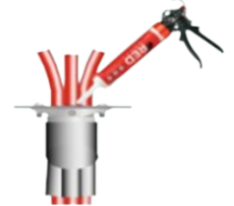
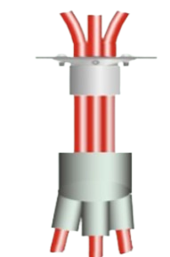
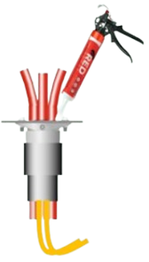
CP411-2: HV jointing manual
  This update covers glanding of triplexed cables into cable boxes using “Bolted Top Hat Glands”.
  What’s changed?
  The supplier of the metal gland kits is now REPL.
  These kits now come with an additional, heat shrinkable, three-core breakout for sealing the triplex cables. For any arrangement where the cable earth screen wires need to be taken out of the box, a heat shrink tube is still supplied in the kit and can be used instead.
  Method to seal the small gap between the cables in a triplex arrangement updated to use the new duct sealing mastic, applied using the caulking gun.
Once gland is completed, the new duct sealing mastic can be used to fill inside of gland body.
CC 190010 – Red Mastic
CC 190012 - Gun
Three-core heat shrink breakout now included in the kit to be used on triplex cables to improve sealing onto the gland body.
Commodity Codes for Gland Kits (same codes, different supplier):
CC144397 – Bolted Gland Kit for 95mm2 triplex
CC144399 – Bolted Gland Kit for 185/300mm2 triplex
Document in CP411Pt2 where this change has been updated:
Section 2 – Standard Technique 42
If the copper earth wires need to be taken out of the cable box, then a sealing tube (included in the kit) can be used instead of the breakout.

Slide 4
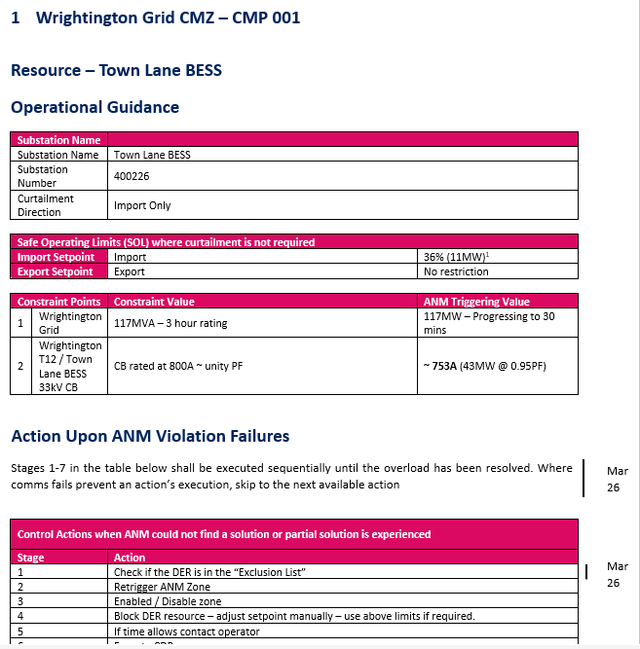
CP608: System Control
  Update to Operational Procedures and Constraint Management Procedures
Update to Operational Procedure - OP94 Coal Pit Lane BESS
      Incorrect reference to Hyde Grid removed and replaced with Atherton Grid.
  Update to Constraint Management Procedure 1 – Wrightington CMZ.
      Additional control action introduced to check if DER is in Exclusion List.

Slide 5
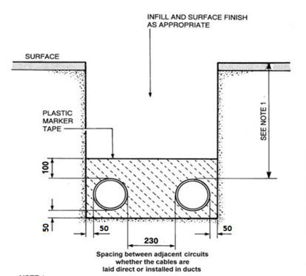

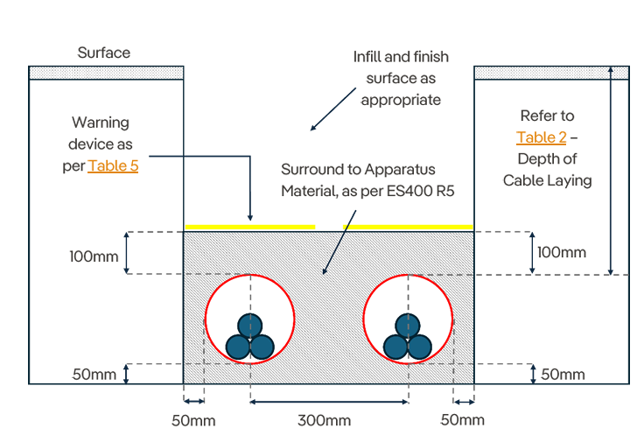
ES400 E4: Installation & repair of 11kV and LV cables
  Updated requirements for space between cables in multiple runs and cable duct sizes, information added on LV cables in footpaths.
  Cable spacing
  Horizontal and vertical spacing between cables in multiple runs updated in line with industry standards – distance now measured from center-point of cable, instead of edge of cable/duct.
  Drawings and table updated to reflect these changes.
  Cable duct sizes
  Table removed from CP410 and inserted here – showing duct sizes required for LV, 6.6kV and 11kV cables.
  LV cables in footpaths
“The most cost-effective method shall be used for installing the cables, and the installer should aim to use a minimal number of joints wherever practical.”
Before
90mm reduction in trench width for multiple ducts at 6.6/11kV
After

Slide 6

ES400 I4: OHL Insulators
  Minor update to remove references to the Ceramic Coach Bolt.
  The document has been updated to the new template.
  References to the ‘Ceramic Coach Bolt’ (CC125205) removed as this is no longer available.

