Slide 1
LAEP high level engagement process: Electricity North West with Local Authorities
Christos Kaloudas
Capacity Strategy Lead Manager, Asset & Technology Directorate
26th April 2023

Slide 2
Terms of reference – ENW & councils engagement
Objective: what’s the task?
Technical Support
Facilitation of Local Area Energy Plans (LAEPs)
Flexibility Services
Electricity North West to provide technical support to local authorities for LAEPs: guidance on the use of ENW planning data.
ENW to release network capacity where & when needed to facilitate all LAEP and other local plans in their planned timeline.
ENW to explain our DSO flexibility service opportunities for local service providers.

Slide 3
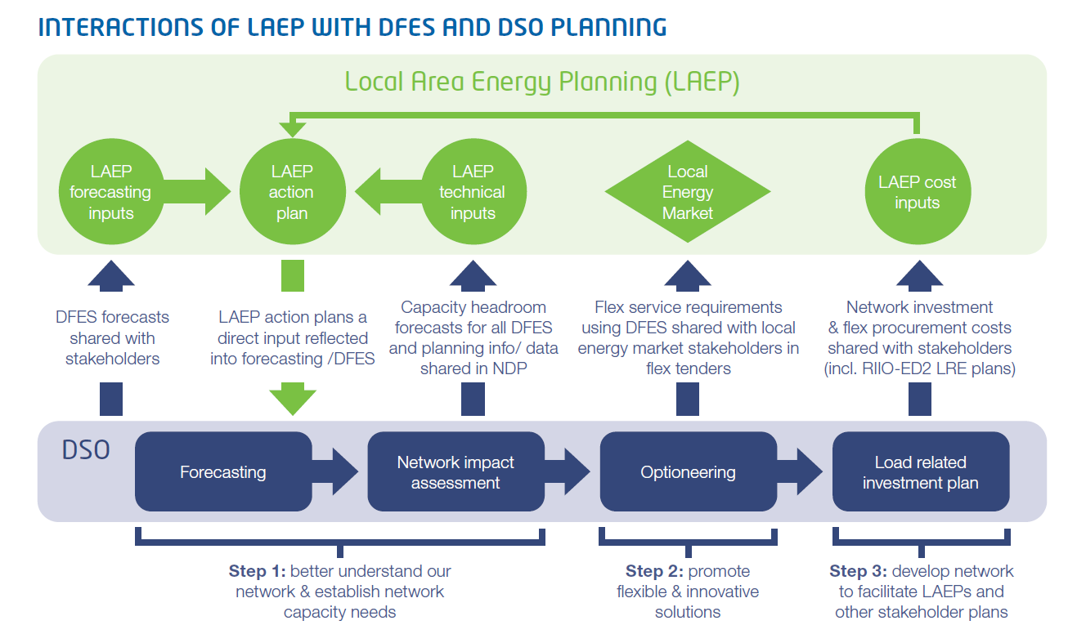
ENW support to Local Area Energy Plans (LAEPs)
LAEPs:
local authorities (LAs) expected to act as coordinators of LAEPs
ENW’s main role: to assist LAEP development by sharing data & technical insights
ENW to facilitate LAEPs: mature LAEP action plans need to be shared with ENW to timely release network capacity

Slide 4
ENW - local authorities engagement
County council (eg, GMCA) – ENW bilaterals: workshop every 6 months
Councils – ENW bilaterals: quarterly meetings with each individual council (both face-to-face and remote meetings)
ENW points of contact: LAEP engineers from our Capacity Strategy team (Ivan & Michael)
Ivan Bolotkov
(experience: ENW & UKPN planning, ABB and other)
Michael Keddy
(experience: ENW connections, Arup and other)

Slide 5
Importance of LAEP engagement
Why is it important for LAs to share LAEP and other plans before applying for network connection?
network capacity released within LAEP / local plan timeline
cost-efficient network investment, not piecemeal network expansion → lower energy bills to customers
What is different in RIIO-ED2? (our regulatory 2023-2028 period)
lower connection charges (access SCR charges): higher connections activity expected
access to funding for all DNOs through uncertainty mechanisms → to facilitate well justified LAEPs and other mature local plans
key takeaway: early engagement on LAEPs and other local plans can facilitate them in timely and cost-efficient manner

Slide 6
Protocol of engagement: data to be requested
Data on LAEPs & other local plans
from detailed to more high level: ENW data template (next slide)
grouping developments in high certainty and more ambitious
realistic approach on certainty, ie longer term plans de facto have lower certainty
what is a high certainty development?
strong local/central government backing
secure funding
ongoing development
key takeaway: we will provide a framework to identify high certainty projects, but this is more of a starting point in our LAEP engagement with LAs and we are flexible to use any evidence/info provided by LAs

Slide 7
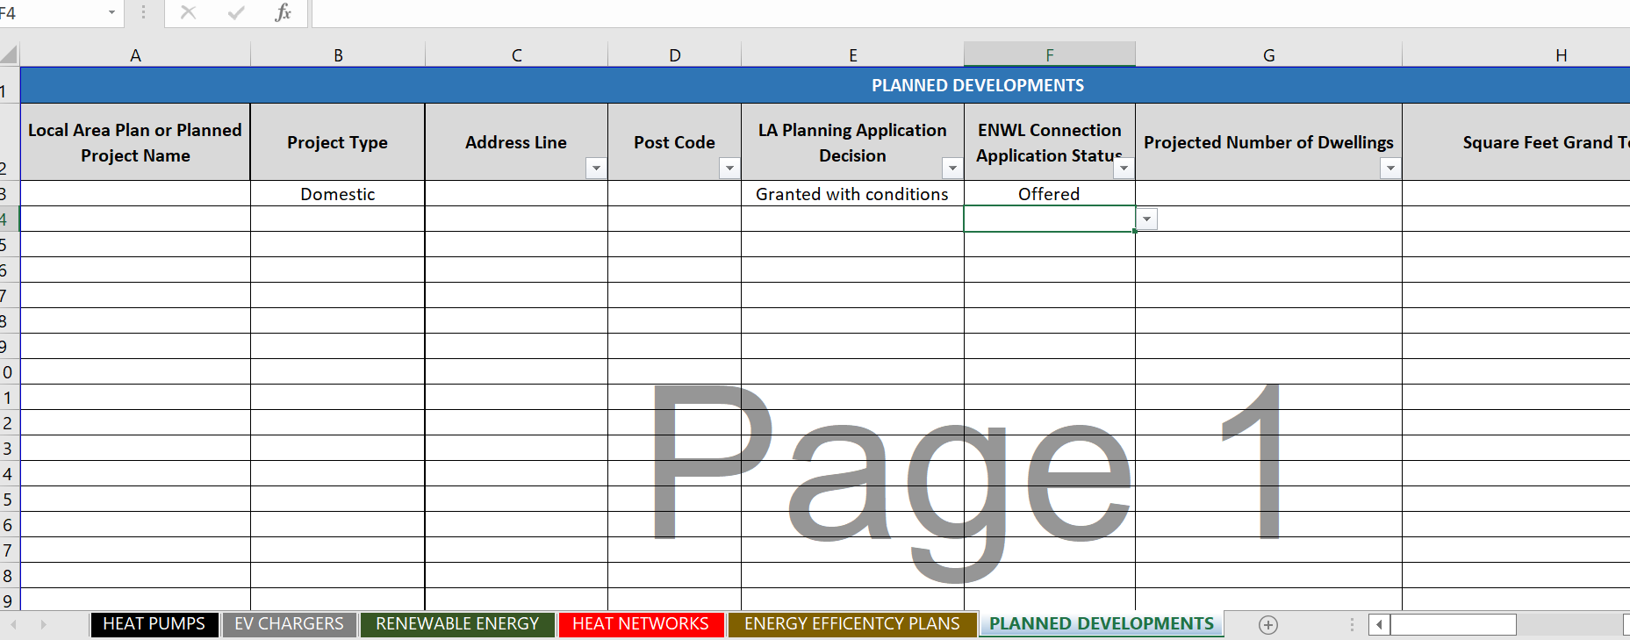
Protocol of engagement: data to be requested
ENW data template to be completed by local authorities & local developers
tabs on key electric technologies: EVs, heat pumps, renewables, heat network plans
a generic “planned developments” tab can be also used
key takeaway: we’re flexible in getting more or less accurate/precise information on LAEPs. The bilaterals can be used to discuss details on data

